Slide 1
The Network Layer

Slide 2
Agenda / Content
The Network Layer in the Internet
  The IP protocol
  IP Addressing
  IP subnet design
    CIDR (Classless InterDomain Routing)
    NAT (Network Address Translation)
  Internet Control Protocols
    ICMP (Internet Control Message Protocol)
    ARP (Address Resolution Protocol)
    RARP (Reverse Address Resolution Protocol)
    BOOTP (BOOTstrap Protocol, alternative to RARP)
    DHCP (Dynamic Host Configuration Protocol
  IPv6

Slide 3
RFC
IP 791
ICMP 792
TCP 793
768 UDP
826 ARP
903 RARP
951 BOOTP

Slide 4
Packet,
  is the fundamental unit of information carriage in all modern computer networks that use packet switching. Packet consists of three elements:
    Header, Data, Trailer
Datagram,
  often called a packet, is much more atomic in nature. It is a small piece of data, often required to be less than a maximum length (typically in the 256 to 2000 byte range). Datagrams are completely self contained. They have a source and a destination, but nothing that could be called a connection. Datagrams have no relationship to any others that came before or after them.

Slide 5
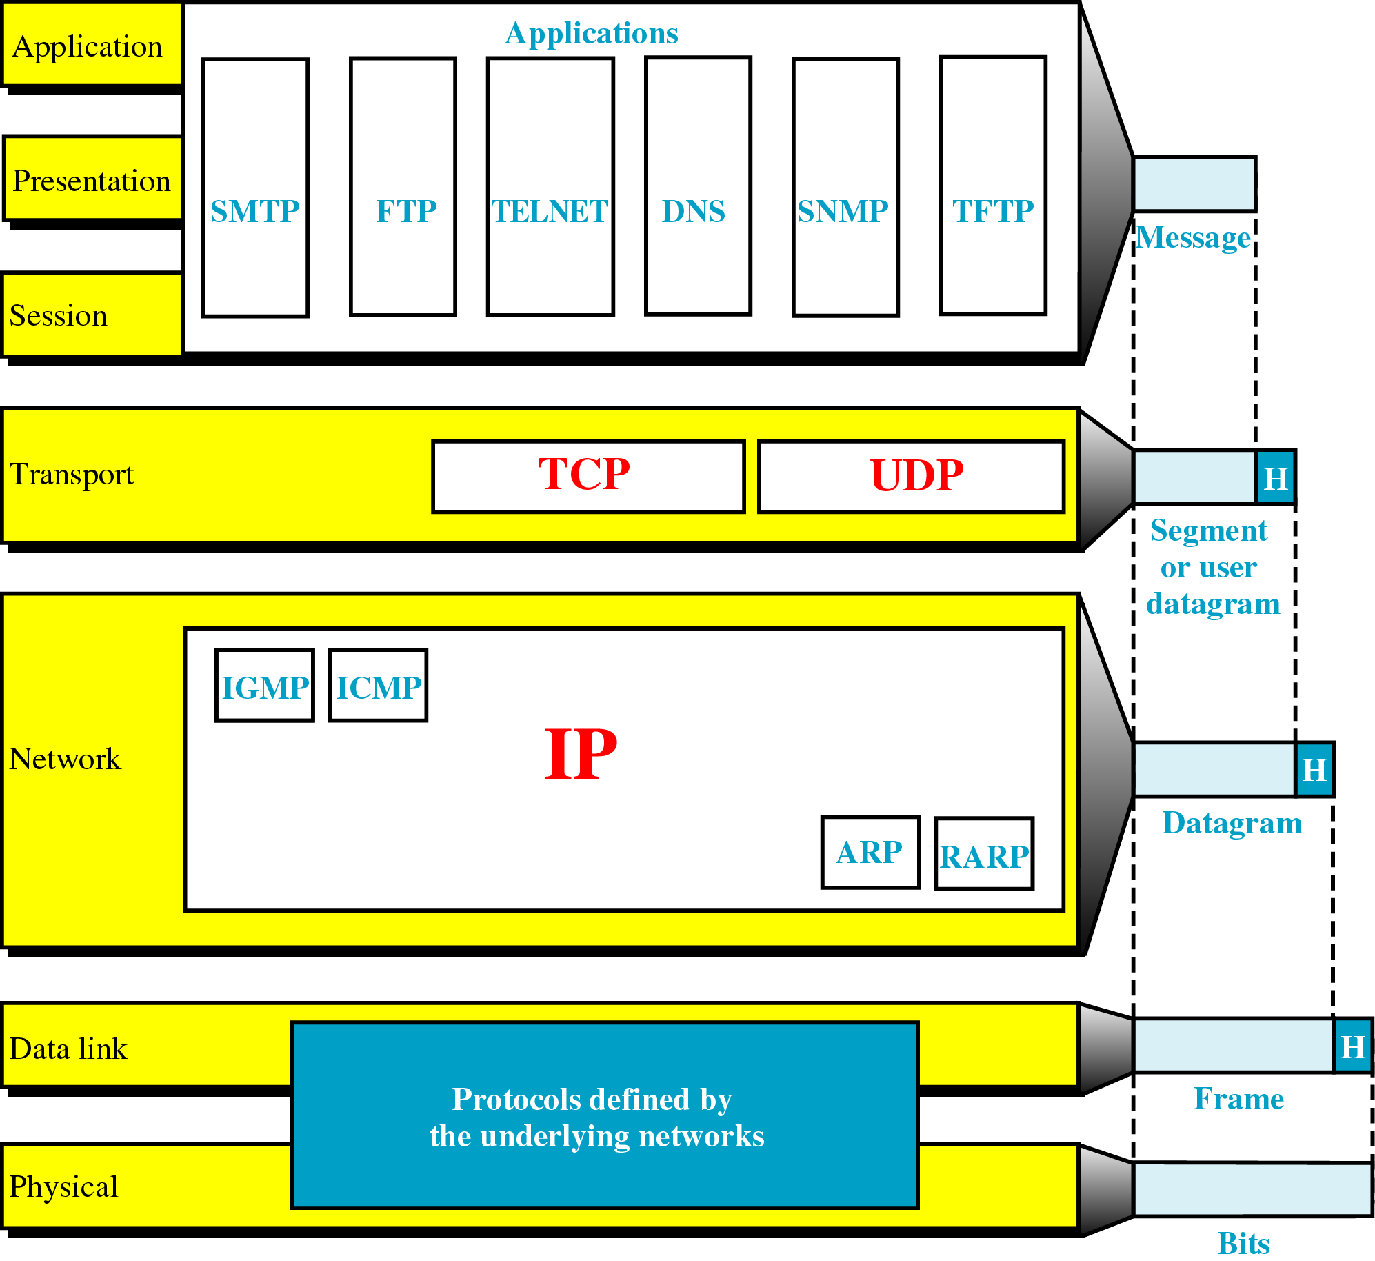
The network layer in the Internet

Slide 6
Principles that drove the design
Make sure it works – first test and then write specs
Keep it simple – fight features (leave out non essential features)
Make clear choices – if multiple ways to do same thing, choose just one
Exploit modularity – have protocol stacks
Expect heterogeneity – different types of hardware, etc..
Avoid static options and parameters – negotiate a value than define a fixed one (where absolutely needed)
Look for a good design, not need to be perfect – do a god design, don’t complicate it to handle special wired cases
Be strict when sending, tolerant when receiving – comply with the standards when sending, try to accommodate errors when receiving
Think about scalability – systems that have to use millions of users don’t accommodate well centralized databases
Consider performance and cost – a solution that is either expensive or performs poorly is not usable

Slide 7
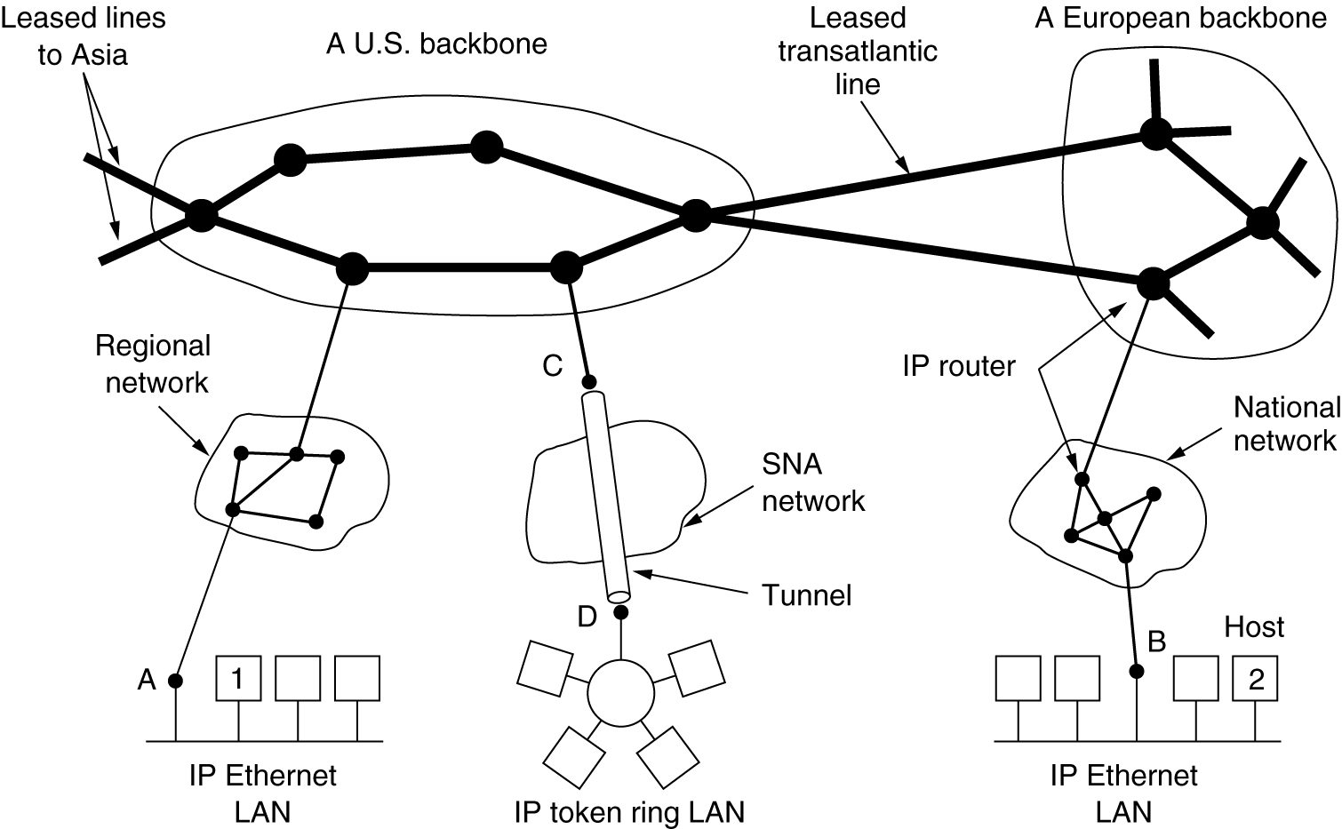
Internet – collection of subnets

Slide 8
Internet Protocol (IP)
The glue that holds together the Internet
Provides a best-efforts (not guaranteed) way to transport datagrams from source to destination
Workflow:
  The transport layer takes the data streams and breaks them into datagrams (in theory they can be up to 64KB, but in practice they are no more than 1500 bytes)
  Each datagram is transmitted through the Internet (possible being fragmented into smaller pieces as it goes)
  When all pieces get to the destination machine, they are reassembled by the network layer into the original datagram
  This datagram is handed to the transport layer which inserts it into the receiving process input stream

Slide 9
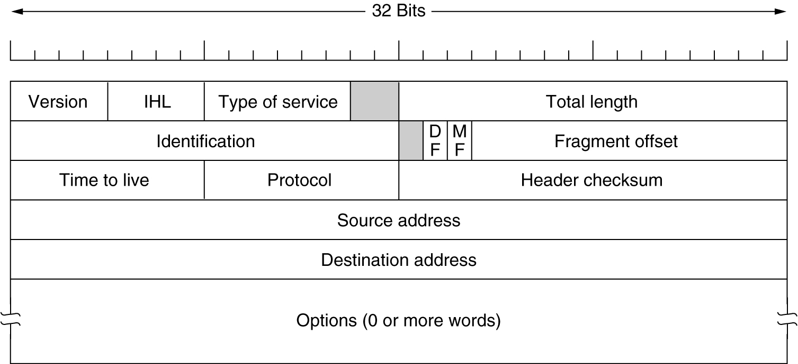
Format of the IP datagram
Versioning (keeps track of the versioning control). Currently we can have IPV4 (0100) or IPV6 (0110)
Header Length – how long the header is in 32 bit-words; the minimum value is 5, which applies when no option is present; maximum value is 15 giving a maximum of 60 bytes for the header, when options are present (thus options field is limited to 40 bytes)
Type of service – defines how the datagram should be handled; it includes bits that define priority of the datagram; it also include bits that define the type of service the sender desires, such as level of throughput, reliability and delay; most of the times, this filed is completely ignored by routers
Total length – includes everything in the datagram, both header and data; the maximum length is 65,535 bytes; at this stage, this limit is OK, but with future gigabit networks, larger datagrams may be needed
Identification – is needed to allow the destination host to determine which datagram a newly arrived fragment belongs to. All the fragments of the datagram contains the identification field.
DF – bit specifying Don’t Fragment; this is helpful for systems that can’t put back together the fragments of a datagram
MF – stands for More Fragments; all fragments except the last one have this bit set. It is needed to know when the fragments of a datagram have arrived
Fragment offset – tells where in the current datagram the current fragments belongs. All fragments, except the last one have to be multiple of 8 bytes (elementary fragment unit); since 13 bits are provided, there are a number of 8192 fragments per datagram, giving a maximum datagram length of 65536 bytes
Time to live – is a counter used to limit the packets life times; it is suppose to count time in seconds, allowing a maximum life time of 255 seconds, but in practice it counts only hops. When it hits 0, the packet is discarded and a warning packet is sent back to the host; this feature prevents datagrams from going around forever.
Protocol – tells which transport process to give it to…in other words is specifies the transport layer protocol (TCP, UDP, etc…)
Header checksum – verifies only the header; the algorithm is to add up all 16 bit half words as they arrive, using one’s complement arithmetic and then take one’s complement result; the header checksum must be computed at each hope, since there are values in the header that modifies (i.e. hops count)
Source address and destination address indicate the network number and host number; we will see next what that means;
Options – was designed to allow designers and implementers of network protocols an escape mechanism; this option value allows for subsequent version of the protocols to include information not present in the original specs; the options are variable length, each of them beginning with one byte identifying the option.
Notes:
IP packet is transferred in big endian : from left to right, with the high order bit of the version control going first. All 8086 based machines are little endian, so whenever sending or receiving, a conversion is required
Versioning (keeps track of the versioning control). Currently we can have IPV4 (0100) or IPV6 (0110)
Header Length – how long the header is in 32 bit-words; the minimum value is 5, which applies when no option is present; maximum value is 15 giving a maximum of 60 bytes for the header, when options are present (thus options field is limited to 40 bytes)
Type of service – defines how the datagram should be handled; it includes bits that define priority of the datagram; it also include bits that define the type of service the sender desires, such as level of throughput, reliability and delay; most of the times, this filed is completely ignored by routers
Total length – includes everything in the datagram, both header and data; the maximum length is 65,535 bytes; at this stage, this limit is OK, but with future gigabit networks, larger datagrams may be needed
Identification – is needed to allow the destination host to determine which datagram a newly arrived fragment belongs to. All the fragments of the datagram contains the identification field.
DF – bit specifying Don’t Fragment; this is helpful for systems that can’t put back together the fragments of a datagram
MF – stands for More Fragments; all fragments except the last one have this bit set. It is needed to know when the fragments of a datagram have arrived
Fragment offset – tells where in the current datagram the current fragments belongs. All fragments, except the last one have to be multiple of 8 bytes (elementary fragment unit); since 13 bits are provided, there are a number of 8192 fragments per datagram, giving a maximum datagram length of 65536 bytes
Time to live – is a counter used to limit the packets life times; it is suppose to count time in seconds, allowing a maximum life time of 255 seconds, but in practice it counts only hops. When it hits 0, the packet is discarded and a warning packet is sent back to the host; this feature prevents datagrams from going around forever.
Protocol – tells which transport process to give it to…in other words is specifies the transport layer protocol (TCP, UDP, etc…)
Header checksum – verifies only the header; the algorithm is to add up all 16 bit half words as they arrive, using one’s complement arithmetic and then take one’s complement result; the header checksum must be computed at each hope, since there are values in the header that modifies (i.e. hops count)
Options – was designed to allow designers and implementers of network protocols an escape mechanism; this option value allows for subsequent version of the protocols to include information not present in the original specs; the options are variable length, each of them beginning with one byte identifying the option.

Slide 10
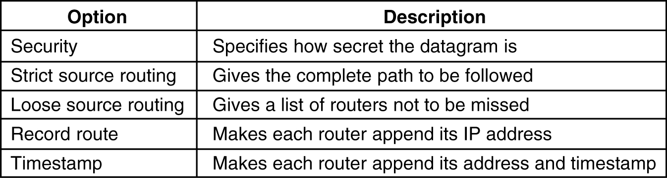
IP Options
Security – i.e., a military router might use this field not to route through certain countries; in practice, all of the routers ignore it, so it can be used to spy easily on interesting stuff …
Strict source routing – gives the complete path from source to destination, as a list of IP address (sequence). The datagram is forced to follow that exact route; useful when routing tables are corrupted or for timing measures.
Loose source routing – requires the packet to traverse the list of routers specified, and in the specified order; it allows a pass through other routers on the way; this is useful when avoiding or force passing through certain countries (economical or political reasons)
Record route – tells the routers along the way to append their address to the option list. This allows tracking down of bugs in routing algorithms. At first, ARPANET was having at most 9 routers…so 40 bytes was plenty…but now this is too short.
Time stamp – same with the Record route option, but beside the IP address, the routers have to record also a 32 bit time stamp value; this option is mostly for debugging routing algorithms.
Notes:
Security – i.e., a military router might use this field not to route through certain countries; in practice, all of the routers ignore it, so it can be used to spy easily on interesting stuff …
Strict source routing – gives the complete path from source to destination, as a list of IP address (sequence). The datagram is forced to follow that exact route; useful when routing tables are corrupted or for timing measures.
Loose source routing – requires the packet to traverse the list of routers specified, and in the specified order; it allows a pass through other routers on the way; this is useful when avoiding or force passing through certain countries (economical or political reasons)
Record route – tells the routers along the way to append their address to the option list. This allows tracking down of bugs in routing algorithms. At first, ARPANET was having at most 9 routers…so 40 bytes was plenty…but now this is too short.
Time stamp – same with the Record route option, but beside the IP address, the routers have to record also a 32 bit time stamp value; this option is mostly for debugging routing algorithms.

Slide 11
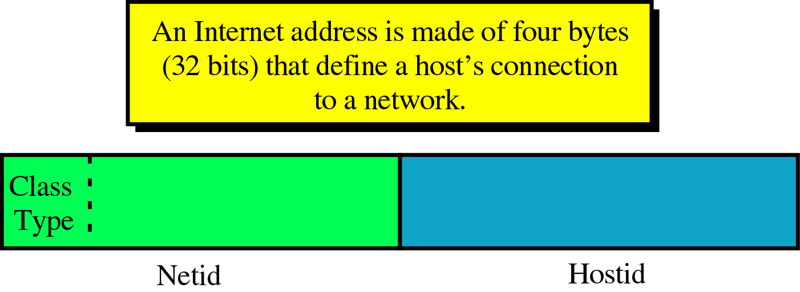
IP Addressing
Three fields of variable sizes (dependent on the class of the address)
  Class Type field defines the class (5 possible classes that an internet address is part off)
  Network ID – up the class type, this field can be anywhere between 7 and 24 bits
  Host ID – up to the class type it can be anywhere between 8 and 24 bits
ICANN (Internet Corporation for Assigned Names and Numbers), non profit corporation that manages the assignment of IP address space to various regional authorities that deal with IP address assignment

Slide 12
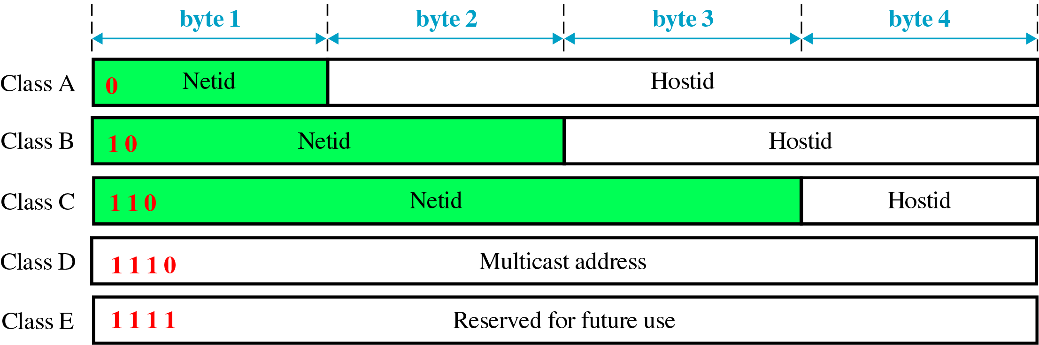
Internet Classes
10011101 10001111 11111100 11001111 (Class B)
11011101 10001111 11111100 11001111 (Class C)
01111011 10001111 11111100 11001111 (Class A)
11101011 10001111 11111100 11001111 (Class D)
11110101 10001111 11111100 11001111 (Class E)
Class A, B are full; class C still has available addresses; D is reserved for multicasting and class E is reserved for future use

Slide 13

Dotted decimal notation
Used to make the form shorter and easier to read
Internet addresses are usually written using this form
Looking at the first byte of an address in decimal form will allow us to determine which class the particular address belongs (for the example it belongs to class B)

Slide 14
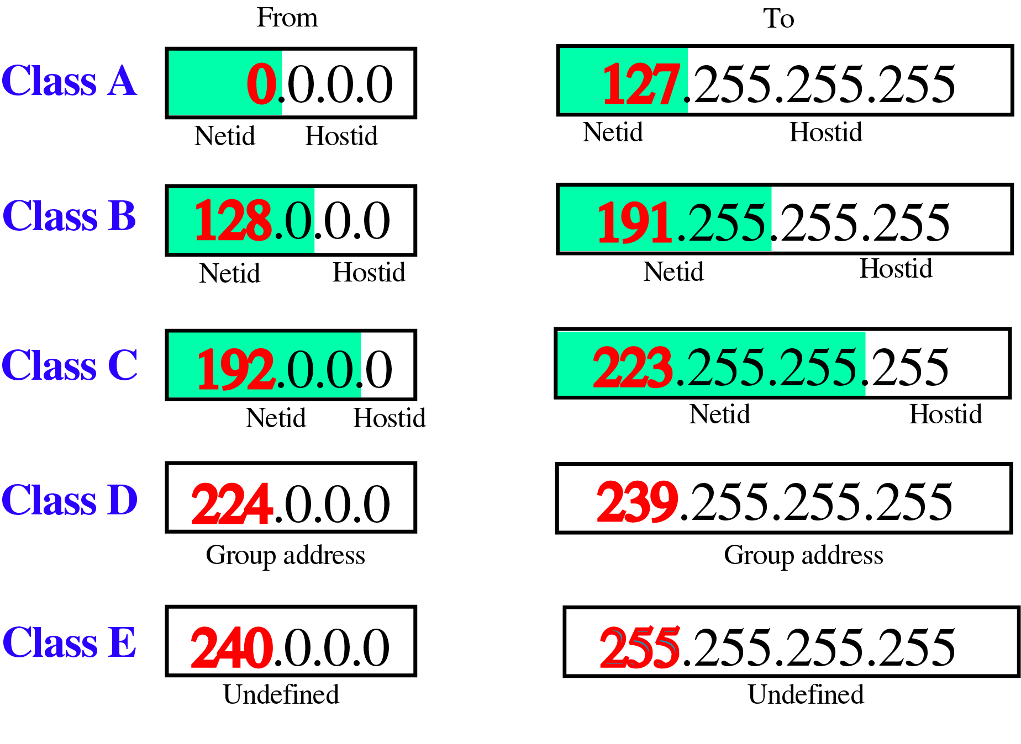
Class ranges for Internet addresses

Slide 15
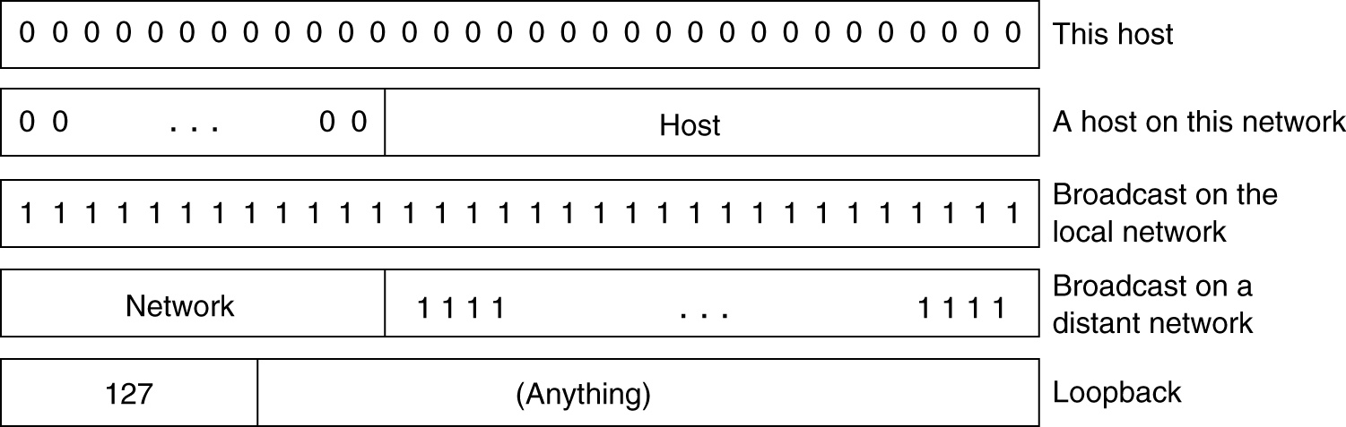
Special IP addresses
Loopback – the packets sent to these addresses are not sent over the wire;
  they are treated as incoming packets and processed locally
  Very useful for testing/debugging an TCP/IP stack

Slide 16
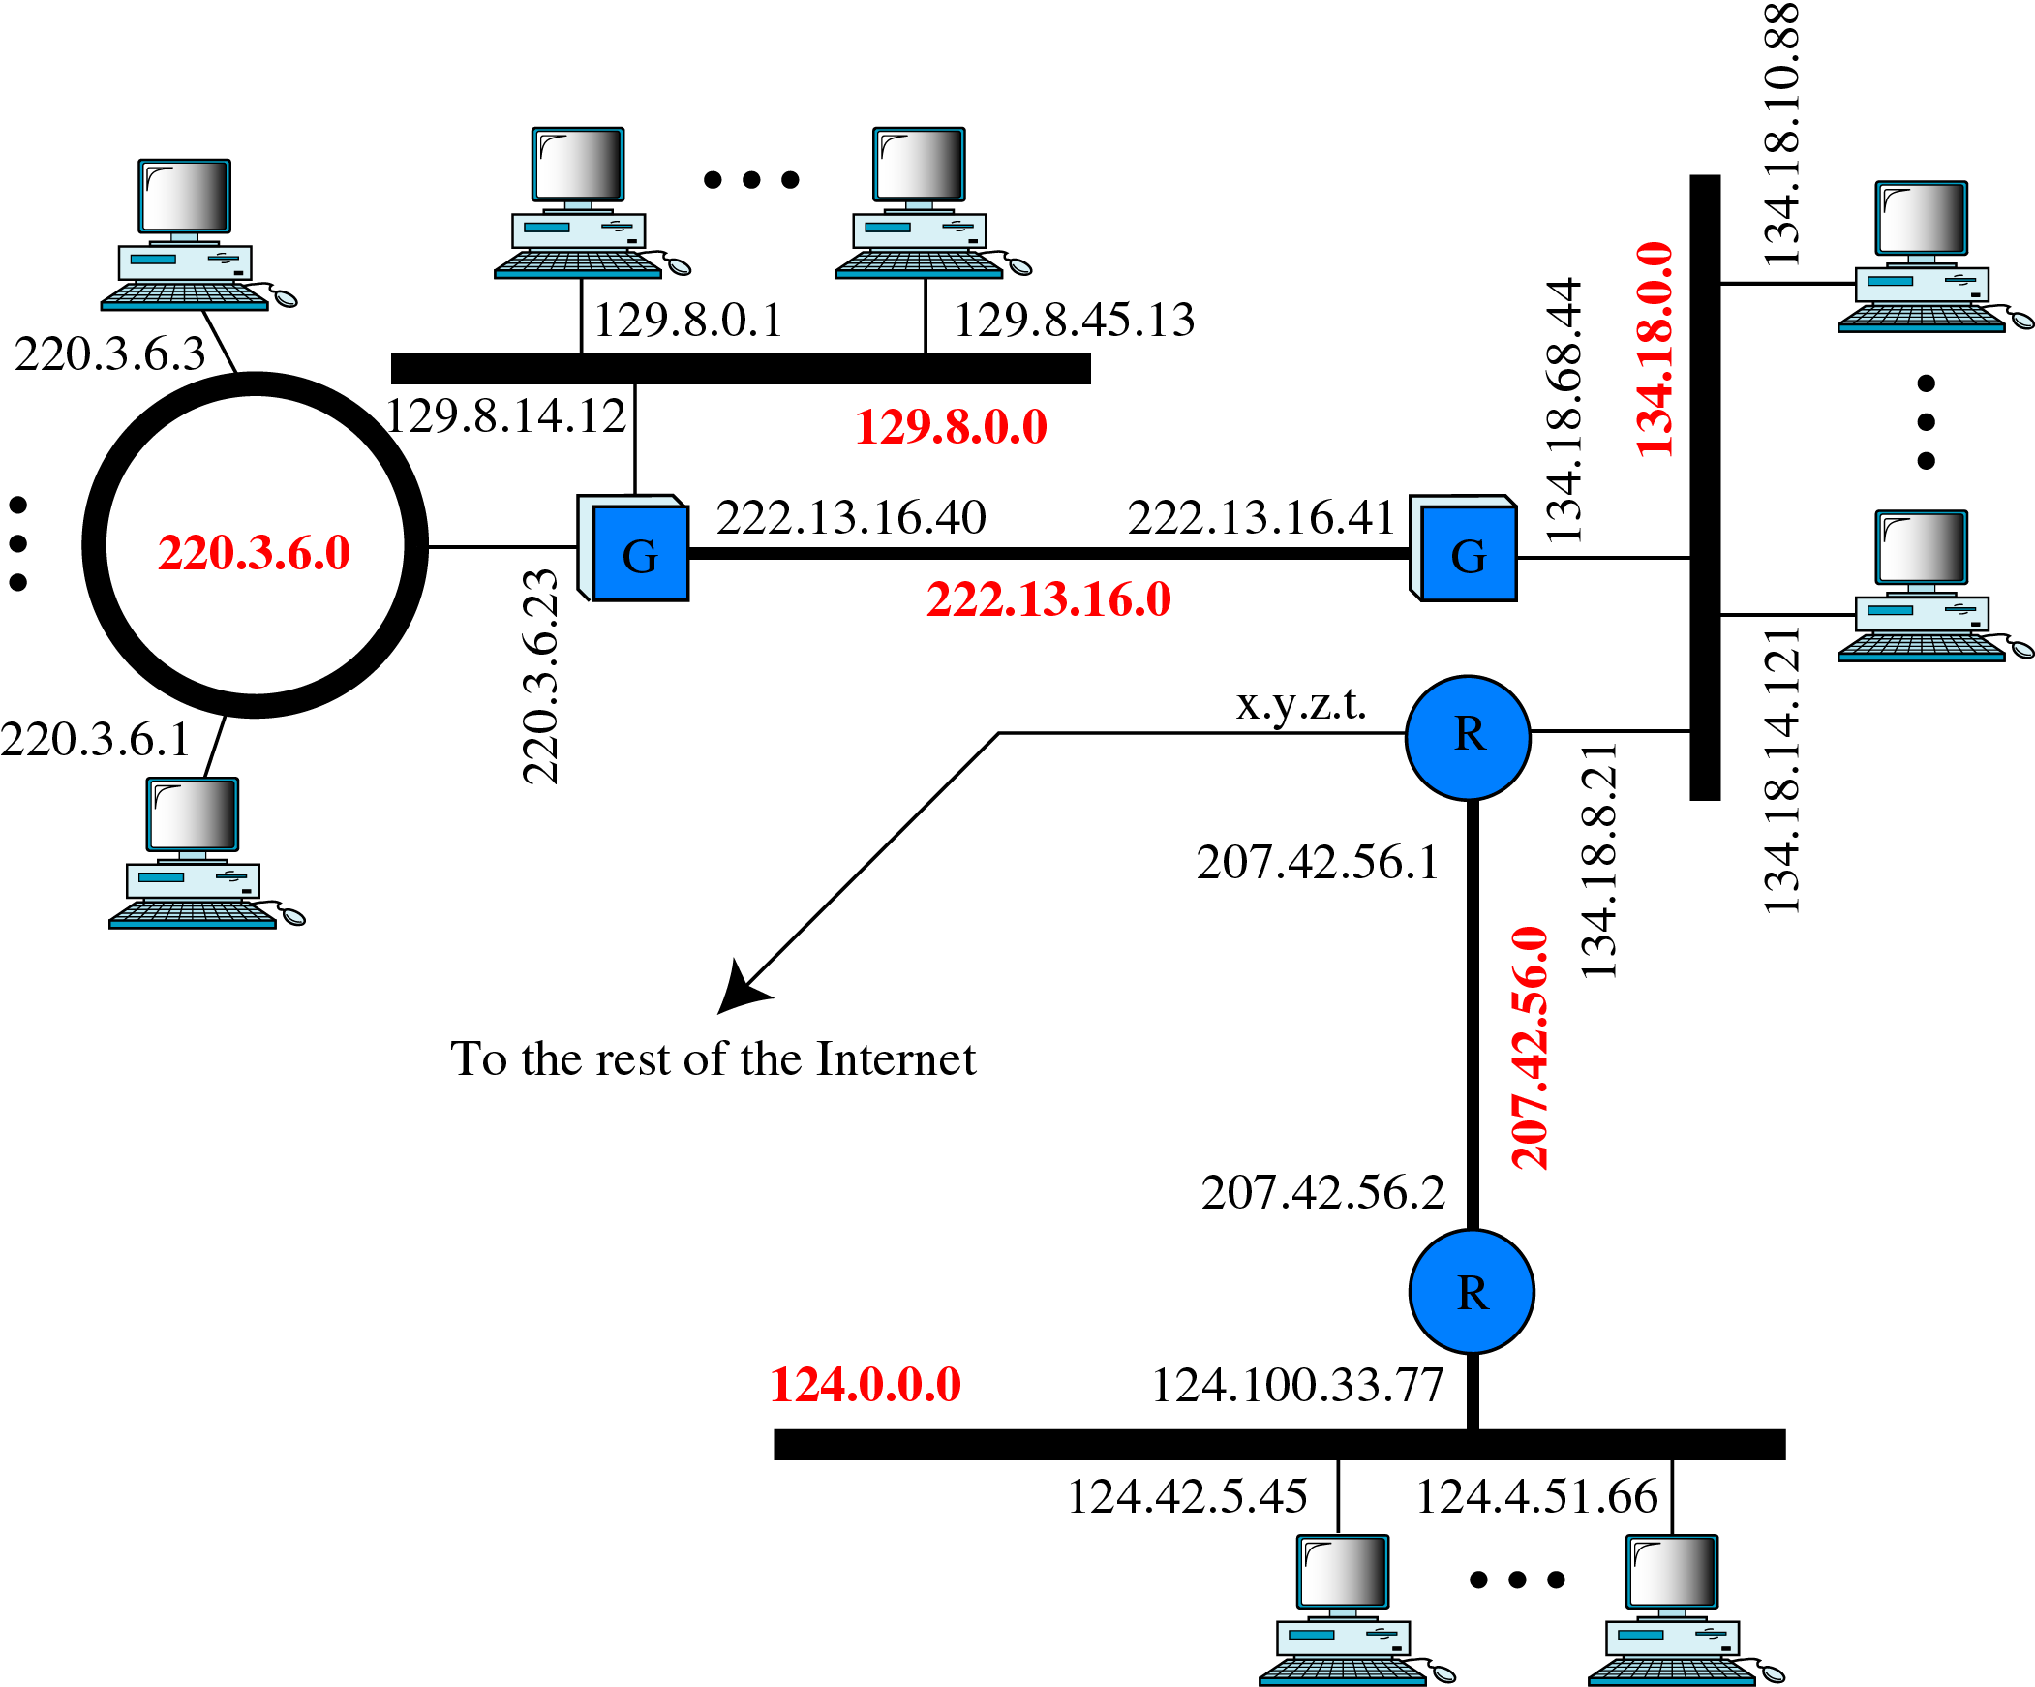
A sample internet
Notes:
Three LANs
One Token Ring
G – gateway
R – router

Slide 17
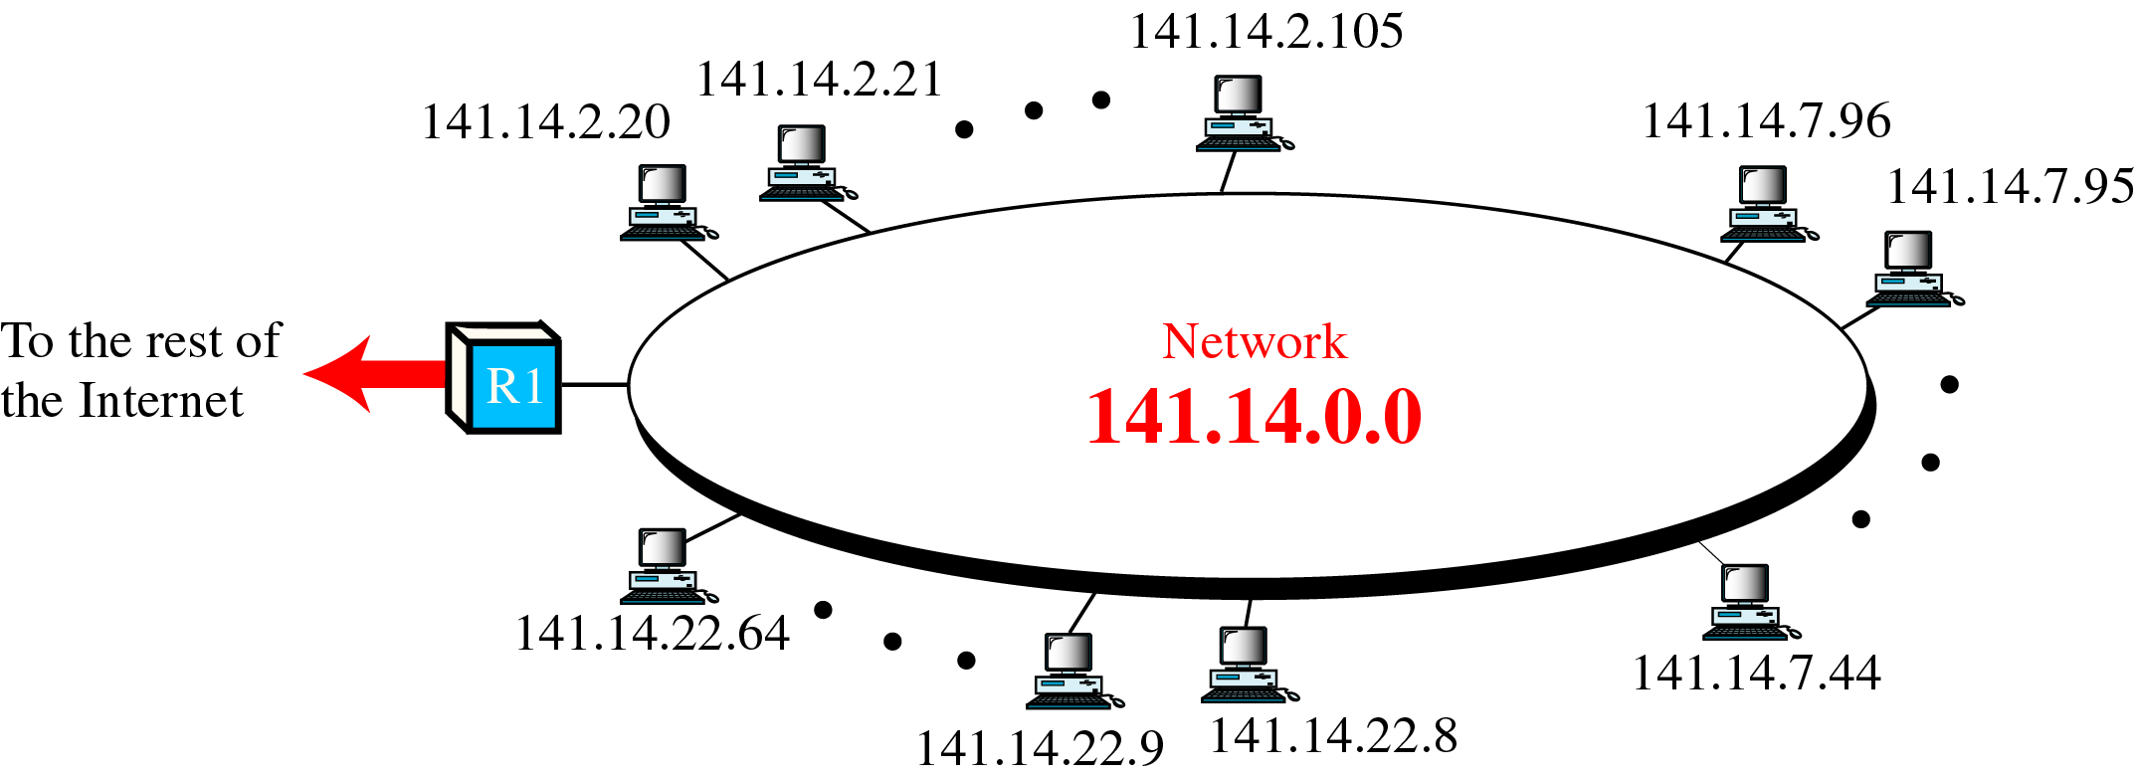
Two levels of hierarchy
As we have seen, all the addresses on Internet have a network id and a host id; this means that there is a hierarchy in IP addressing
To reach a specific host, first we have to reach the network this host is part of, using the first portion of the address; then we will reach the host itself using the second portion of the IP address.
Then, classes A, B and C in IP addressing are designed with two levels of hierarchy

Slide 18
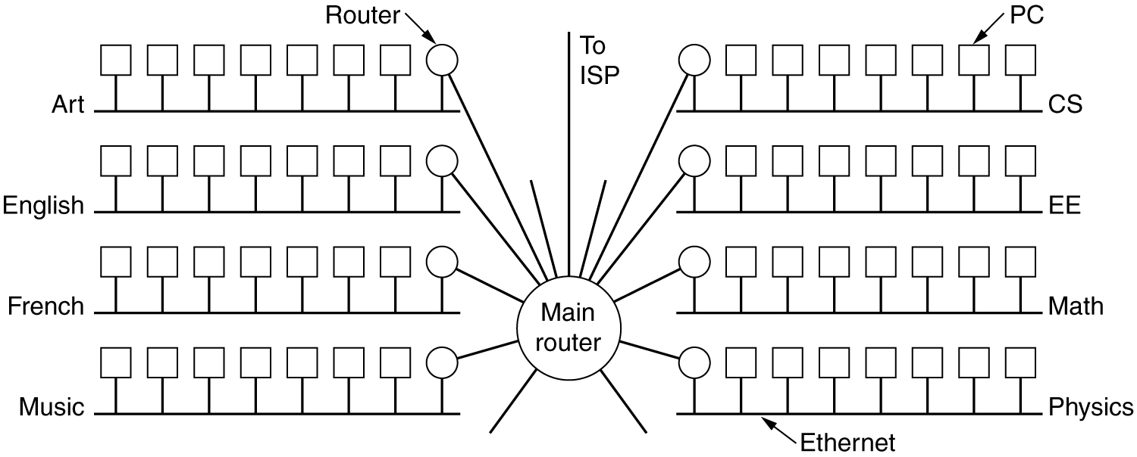
Campus network example
Consider a large organization with class B addresses (140.203.0.0)
With two level addressing schema, the organization can’t have more than one physical network
Solution: allow subnets, allow a network to be split into several parts for internal use, but still act as a single network to the outside world

Slide 19
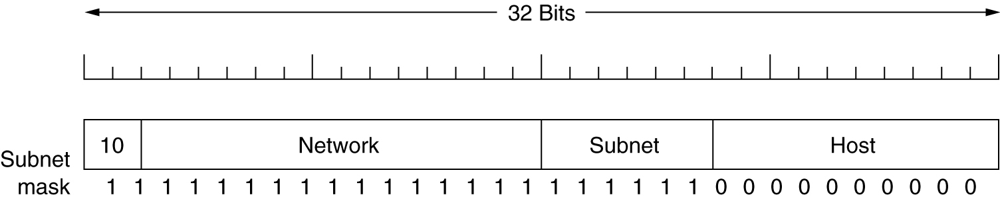
Subnets (1)
Instead of having a single class B address with 14 bits for network and 16 bits for host number, some bits are taken away from the host number to create a subnet number
For example, if the university (large organization) has 35 departments it could use 6 bits for the subnet number and a 10 bit host number, allowing for up to 64 Ethernets, each with a maximum of 1022 hosts (all 0 and all 1 are not allowed); this split can be changed later if it proves to be wrong

Slide 20
Subnets (2)
To implement subnetting, the main router will need a subnet mask that indicates the split between network + subnet number and host number
The masking process extracts the address of the physical network from an IP address (bitwise AND between the IP and mask); masking can be done either we have subnetting or not
Subnet mask is also written in dotted decimal notation or as a slash followed by the number of bits in the network
Subnet mask for this example is 255.255.252.0; an alternative notation is /22 to indicate that the subnet mask is 22 bit long, so we can have 255.255.252/22

Slide 21
Subnets (3)
In our example, the subnets are as follows:
  Subnet 1: 10001100 11001011 000001|00 00000000
    Subnet: 140.203.4.0
    Subnet mask: 255.255.252.0
    First host in the subnet 1: 140.203.4.1
  Subnet 2: 10001100 11001011 000010|00 00000000
    Subnet: 140.203.8.0
    Subnet mask: 255.255.252.0
    First host in the subnet 2: 140.203.8.1
  Subnet 3: 10001100 11001011 000011|00 00000000
    Subnet: 140.203.12.0
    Subnet mask: 255.255.252.0
    First host in the subnet 3: 140.203.12.1
Notes:
Outside the network, the subnetting is not visible, so allocating a new subnet doesn’t require contacting any official organization (that assigns IP addresses) nor changing any external databases

Slide 22
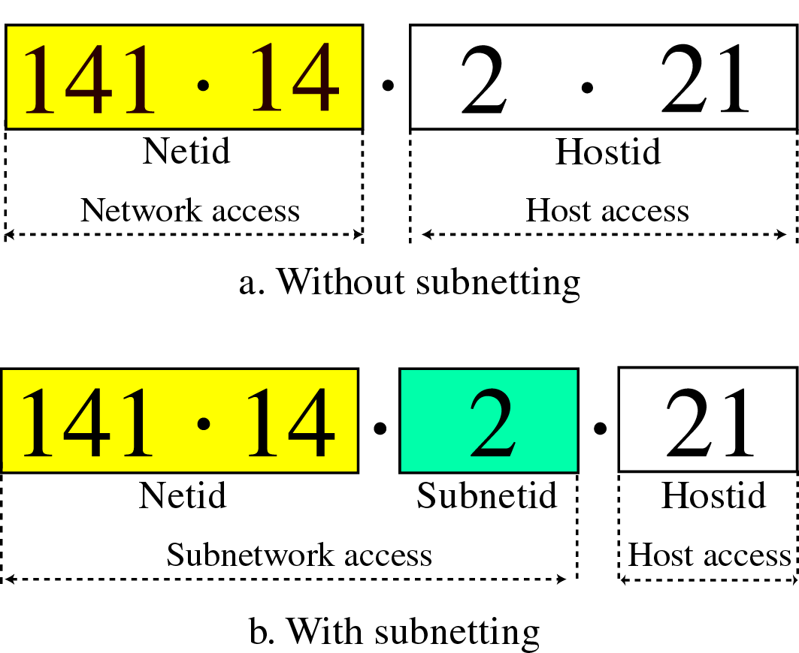
Another Practical example
Consider network address 141.14.0.0, create 256 subnets with 254 hosts per subnet

Slide 23
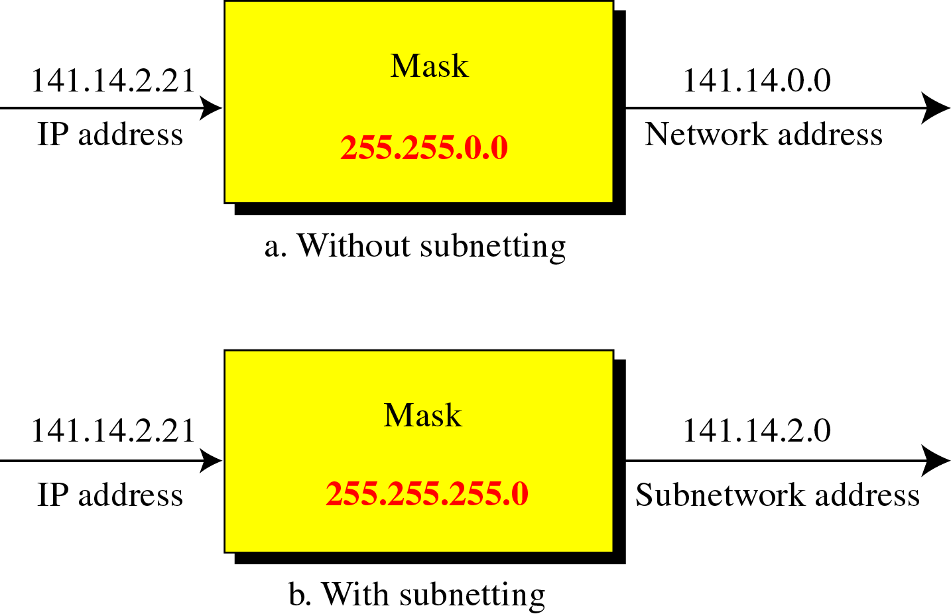
Masking

Slide 24
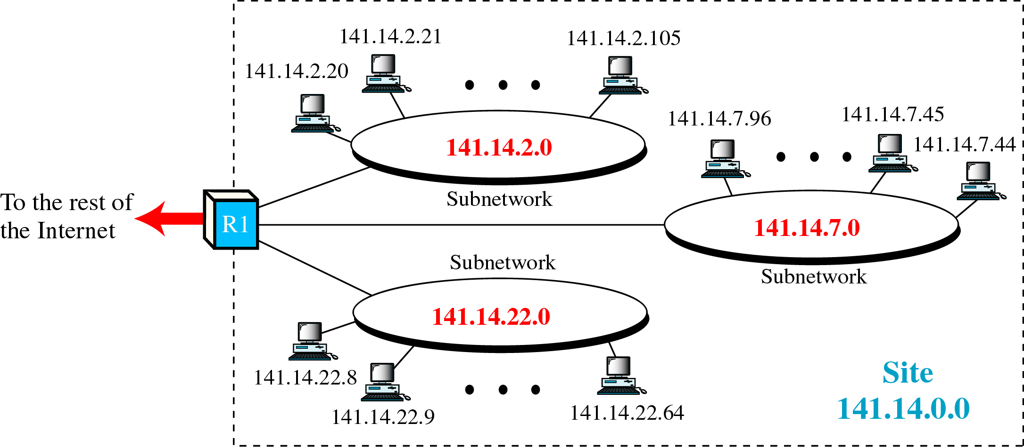
Three level hierarchy network

Slide 25
IP addresses shortage
IP is running out of addresses
  Class A networks (with 16 million host addresses) is too big for most of the organizations
  Class C networks (with 256 host addresses) is too small for most of the organizations
  Class B networks (with 65,536 host addresses) is about right for a medium sized organizations
In reality a class B address is too large for most of the organizations; studies show that half of the class B networks have less than 50 hosts….
Two solutions to cope with the shortage problem
  Use of CIDR (Classless InterDomain Routing)
  Use of NAT (Network Address Translation)

Slide 26
CIDR
Basic idea is to allocate the remaining IP addresses in variable-sized blocks, without regard to the classes.
If a site needs, say 2000 addresses, it is given a block of 2048 addresses on a 2048 byte boundary
Dropping classes makes the routing more complicated, the old routing algorithm is not working anymore

Slide 27
Old routing algorithm
Incoming packet to the router (i.e. with destination address 140.203.8.22
Router extracts the destination IP address and shift a copy of it with 28 bits to the right to obtain a 4 bit class number (i.e. 1000)
Have a 16 way branch that sorts the packet into A, B, C and D (if supported):
  8 cases for class A; 4 cases for class B, 2 cases for class C and one case for each D and E
Once the router knows the class (in our example class B), it will know what mask to apply (i.e. 16 bit mask, or 255.255.0.0), in order to find out the network address (140.203.0.0) and look it up into appropriate class routing tables (class B routing tables) to find out the outgoing physical line

Slide 28
CIDR routing algorithm
Each routing table entry is extended by giving it a 32 bit mask
There is now a single routing table for all networks consisting of (net IP address, subnet mask, outgoing line) triplets
When a packet comes in:
  its destination address is first extracted
  The routing table is scanned entry by entry to find a match
    It is possible to find multiple matches (entries), the one having the longest mask is used (i.e. between /20 entry and /24 entry, /24 is used)
  The packet is forwarded on the outgoing line
Commercial VLSI chipsets for routers have been developed using this new algorithm, in order to speed up the address matching process

Slide 29
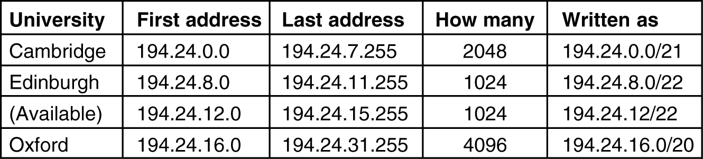
CIDR practical example (1)
Addresses are available at 194.24.0.0
Suppose that:
  Cambridge needs 2048 addresses and it is assigned 194.24.0.0 through 194.24.7.255 with mask 255.255.248.0
  Oxford asks for 4096 addresses and it is assigned 194.24.16.0 through 194.24.31.255 with mask 255.255.240.0
  Edinburgh asks for 1024 addresses and it is assigned 194.24.8.0 through 194.24.11.255 with mask 255.255.252.0

Slide 30
CIDR practical example (2)
The routing tables all over the world will update to contain the following entries:
  C: 11000010 00011000 00000000 00000000 with mask 11111111 11111111 11111000 00000000
  E: 11000010 00011000 00001000 00000000 with mask 11111111 11111111 11111100 00000000
  O: 11000010 00011000 00010000 00000000 with mask 11111111 11111111 11110000 00000000
Packet coming for destination 194.24.17.4 or in binary: 11000010 00011000 00010001 00000100
  First it is ANDed with Cambridge mask
    11000010 000110000 00010000 00000000, this value doesn’t match the Cambridge base address

Slide 31
CIDR practical example (3)
  The original address is ANDed with Edinburgh mask:
    11000010 000110000 00010000 00000000, this value doesn’t match the Edinburgh base address
  Next original address is ANDed with Oxford mask:
    11000010 000110000 00010000 00000000, this does match the Oxford base address
If no other matches are found, then the packet will be forwarded on the outside line corresponding to the Oxford entry.

Slide 32
NAT (Network Address Translation)
It comes into play whenever a need for more hosts than real IP addresses are available (i.e. an ISP may have a class B address, having a 65,534 possible hosts, but has more customers than that)
NAT (RFC 3022) – basic idea is to assign each company a single IP address (or a small number of them) for Internet traffic. Within company, every computer gets a unique IP address, which is used for routing internal traffic; when a packet exits the company and goes to the ISP, an address translation takes place
To make this thing possible, three ranges of IP addresses have been declared as private, companies can use them internally as they wish; the only rule is that no packets containing these addresses may appear on the internet itself

Slide 33
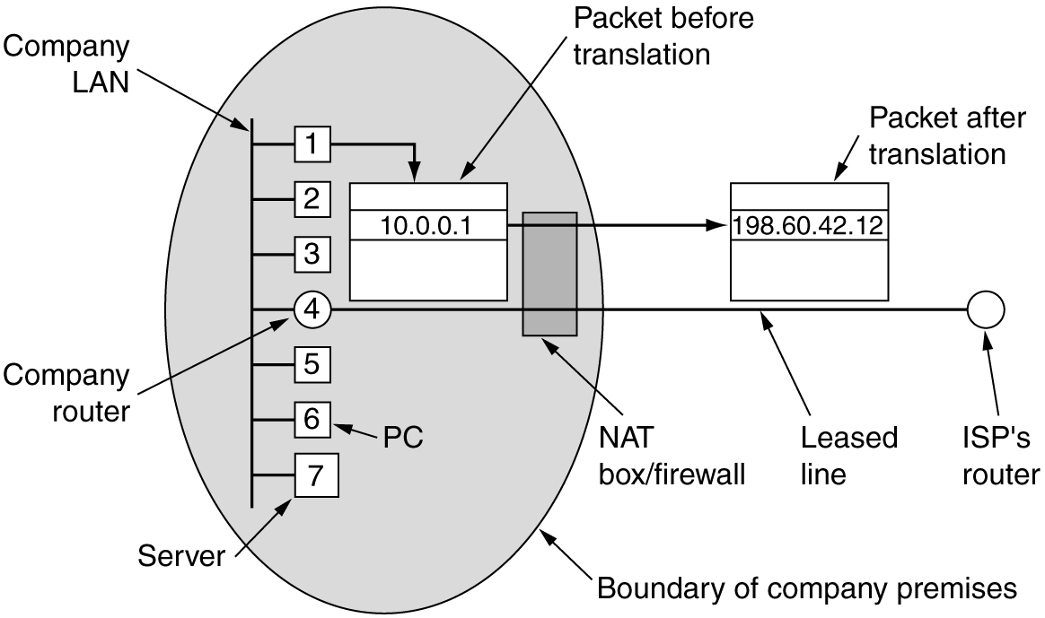
NAT
10.0.0.0 – 10.255.255.255/8 (16,777,216 hosts)
172.16.0.0 – 172.31.255.255/12 (1, 048,576 hosts)
192.168.0.0 – 192.168.255.255 (65,536 hosts)

Slide 34
NAT Operation
10.0.0.3
Web server
140.203.8.22
140.203.8.22
5503
80
Payload
(request)
host
10.0.0.3
140.203.14.66
10.0.0.3
140.203.14.66
140.203.8.22
10.0.0.0
140.203.8.22
NAT
140.203.8.22
5001
80
5503
80
5001
80
Payload
(request)
140.203.8.22
Payload
(request)
Payload
(request)
10.0.0.3
80
5503
Payload
(response)
10.0.0.1
140.203.14.66
NAT translation table
Index
Orig Source Port
Orig IP Address
5001
5503
10.0.0.3
…
…
…
140.203.8.22
140.203.14.66
80
5001
Payload
(response)
140.203.8.22
140.203.8.22
10.0.0.3
NAT
140.203.14.16
80
5503
80
5001
host
10.0.0.4
Payload
(response)
Payload
(response)
NAT box

Slide 35
NAT problems
Violates the architecture of IP model, which states that every host worldwide should be identified by a unique IP
Changes the Internet from a connectionless network in a kind of connection-oriented network
Violates the most elementary rule of protocol layering, that layer k should not make any assumption of what layer k+1 put in the payload
Will not work with any protocols on the Internet (beside TCP or UDP)
Some applications insert IP addresses in the text (payload); the receiver will extract these addresses and use them; NAT will not work with those applications since it doesn’t know about this insertion (i.e. MS Messenger)

Slide 36
Internet Control Protocols
ICMP (Internet Control Message Protocol)
ARP (Address Resolution Protocol)
RARP (Reverse Address Resolution Protocol)
BOOTP (BOOTstrap Protocol, alternative to RARP)
DHCP (Dynamic Host Configuration Protocol)

Slide 37
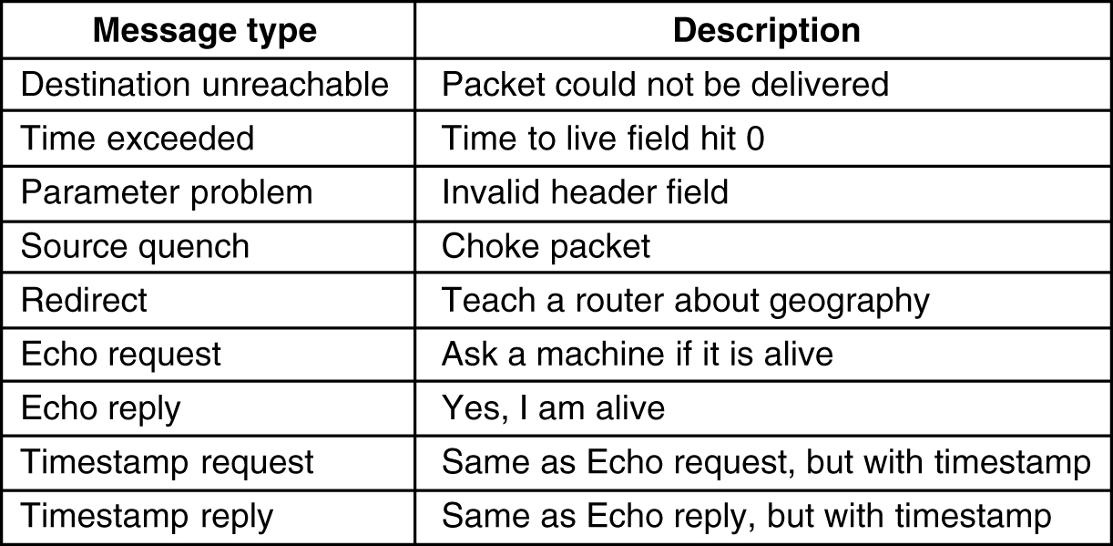
ICMP
Used to report something unexpected; each ICMP message is encapsulated in an IP packet
Used to test the internet
Destination unreachable – is used when the subnet or a router can’t locate the destination or when a packet with DF bit set can’t be delivered because a “small packet” network stands in the way
Time exceeded – is sent when a packet is dropped because its counter reached zero; this event is a symptom that packets are looping, there is an enormous congestion or the timer values were set to low
Parameter problem – indicates that an illegal value has been detected in a header field; this message indicates a bug in the sender’s IP software or possible in the transited routers
Source quench – message formerly used to slow down stations that were sending too many packets; it is not used anymore, because when congestion occurs, those packets tend to throw more fuel into the fire; congestion control is done now in the transport layer
Redirect – is used when a router notices that a packets seem to be routed wrong. It is used by the router to tell the sending host about the probable error
Echo and Echo reply – are used to see if a given destination is reachable and alive; upon receiving the echo message, the receiving station is suppose to answer with the echo reply message
Timestamp request and Timestamp reply – are similar with echo messages, except that the arrival time of the message and the departure time of the reply are recoded in the reply; it is used me measure network performance
Notes:
Destination unreachable – is used when the subnet or a router can’t locate the destination or when a packet with DF bit set can’t be delivered because a “small packet” network stands in the way
Time exceeded – is sent when a packet is dropped because its counter reached zero; this event is a symptom that packets are looping, there is an enormous congestion or the timer values were set to low
Parameter problem – indicates that an illegal value has been detected in a header field; this message indicates a bug in the sender’s IP software or possible in the transited routers
Source quench – message formerly used to slow down stations that were sending too many packets; it is not used anymore, because when congestion occurs, those packets tend to throw more fuel into the fire; congestion control is done now in the transport layer
Redirect – is used when a router notices that a packets seem to be routed wrong. It is used by the router to tell the sending host about the probable error
Echo and Echo reply – are used to see if a given destination is reachable and alive; upon receiving the echo message, the receiving station is suppose to answer with the echo reply message
Timestamp request and Timestamp reply – are similar with echo messages, except that the arrival time of the message and the departure time of the reply are recoded in the reply; it is used me measure network performance

Slide 38
ARP and RARP
ARP is a network layer (3) protocol and is required to allow a sending station gather address information used in forming a layer 2 frame complete with destination and source MAC addresses
Although ARP is a layer 3 protocol it does not use an IP header, it has its own packet format and is a broadcast on the local LAN within the data field of a layer 2 (Ethernet) frame without needing to be routed.
The Ethernet Type field uses the value 0x0806 to indicate an ARP request and 0x0835 to indicate an ARP response.
If a station does not know its IP address it may send out a RARP (Reverse Address Resolution Protocol) request read by a RARP server which has a table of hardware addresses and IP addresses. The RARP uses the same packet format as the ARP
Most hosts on a network will send out a Gratuitous ARP when they are initializing their IP stack. This Gratuitous ARP is an ARP request for their own IP address and is used to check for a duplicate IP address. If there is a duplicate address then the stack does not complete initialization.
RFC 826 describes ARP in detail, while RFC 903 describes RARP.
Notes:
Every router maintains a table listing IP addresses and respective hardware addresses (e.g. MAC addresses) of devices that exist on the network. This table is called an ARP cache and is referenced by the router when it is looking up a hardware address of a device for which it knows the IP address and needs to forward a datagram to it. If no hardware address is found in the ARP cache then an ARP broadcast is sent on to the adjacent media (ARP only applies to the connecting wire). This broadcast is read by every station including the destination station. The destination station sends back an ARP reply with its hardware address so that the IP datagram can now be forwarded to it by the router.

Slide 39
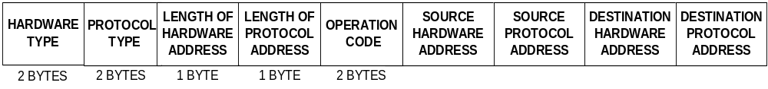
ARP packet format
Hardware Type – (i.e. this is 1 for Ethernet).
Protocol Type - the protocol used at the network layer (i.e. IP).
Length of Hardware Address - this is the length in bytes, so it would be 6 for Ethernet.
Length of Protocol Address - for TCP/IP the value is 4 bytes.
Operation Code - this code indicates whether the packet is an ARP Request, ARP Response, RARP Request or RARP Response.
Source Hardware Address - hardware address of the source node.
Source Protocol Address - layer 3 address of the source node.
Destination Hardware Address - used in a RARP request, the response carries both the destination's hardware and layer 3 addresses.
Destination Protocol Address - used in an ARP request, the response carries both the destination's hardware and layer 3 addresses.

Slide 40
RARP, BOOTP and DHCP
Given an data-link address (i.e. Ethernet address) what is the corresponding net address (IP address)
  RARP
    Is using a broadcasting destination address of all 1s (it is not forwarded by the routers), so a RARP server needs to be in each network
  BOOTP
    Is using UDP messages, so they will be forwarded over routers
    It is specifically designed for diskless stations, so it provides additional information, such as IP of the file server holding the operating system image, etc…
    It requires manual configuration of the tables mapping the IP addresses with Ethernet addresses
  DHCP (Dynamic Host Configuration Protocol)
    Special server that allows automatic and manual IP assignment
    It may require a DHCP relay agent on the local networks, so the DISCOVER packet would be forwarded outside the local LAN
    RFC 2131 and RFC2132

Slide 41
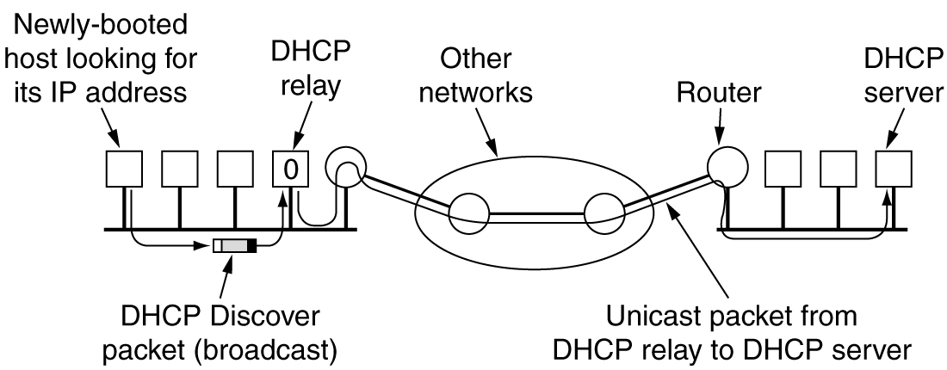
DHCP operation
DHCP relay agent intercepts all broadcast DISCOVER packets and forwards them as unicast packets to DHCP server
DHCP relay agent needs to know the IP address of the DHCP server

Slide 42
IPv6
CIDR and NAT may “buy” a few more years, but the days of IPv4 are numbered (shortage problem)
1990, IETF started to work on IPv6, with the following goals:
  Support billion of hosts
  Reduce the size of the routing tables
  Simplify the protocol, to allow routers to process faster
  Provide better security (auth and privacy) than IPv4
  Pay more attention to type of service (for real time data)
  Aid multicasting (by allowing scopes to be specified)
  Make roaming possible without change of address
  Allow protocol expansion
  Permit the old and new protocols to coexist for years

Slide 43
IPv6 features
16 bytes IP addresses
Header simplification (contains only 7 fields versus 13 fields in IPv4)
Better support for options;
  the way options are represented is different, making it simple for the routers to skip over options not intended for them; this feature speeds up processing in the routers
Improved security features – authentication and privacy are key features of the new protocol.
Better handling of quality of service

Slide 44
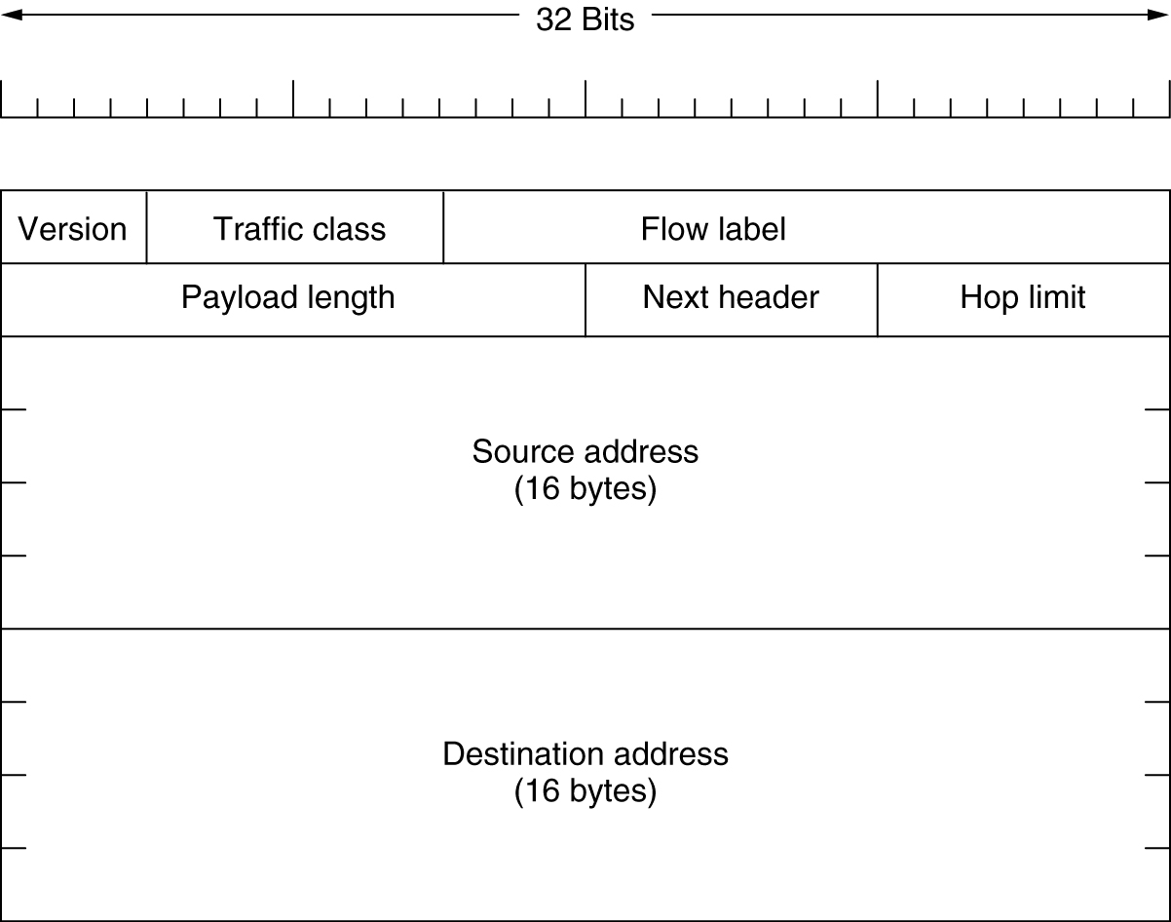
IPv6 header
Version field is always 6 for IPv6 or 4 for IPv4; routers will be able to examine this field and process the packet accordingly
Traffic class – is used to distinguish between packets with different real time delivery requirements
Flow label – experimental field, used to allow a source and a destination to setup a pseudo-connection with particular properties and requirements; i.e. a stream of packets on a certain source host to a certain destination host may have stringent delay requirements, thus need reserved bandwidth.
Payload length – how many bytes follow the 40byte header of the packet. The 40 bytes header is not counted anymore in the length of the packet.
Next header – there can be optional (extra) headers for the given packet. This field tells which (if any) of the currently supported six extension headers follow this header; if this header is the last IP header, the next header field tells which transport protocol handler (TCP, UDP, etc..) to pass the packet to
Hop limit – used to keep packets from living forever; it is practically the same time to live field as in IPv4 header.
Source and Destination address – each 16 bytes. There is a new notation:
8000:0000:0000:0000:0123:4567:89AB:CDEF – eight groups of four hexadecimal digits, with colons between the groups
Notes:
Version - is always 6 for IPv6 or 4 for IPv4; routers will be able to examine this field and process the packet accordingly
Traffic class – is used to distinguish between packets with different real time delivery requirements
Flow label – experimental field, used to allow a source and a destination to setup a pseudo-connection with particular properties and requirements; i.e. a stream of packets on a certain source host to a certain destination host may have stringent delay requirements, thus need reserved bandwidth. The flow can be setup in advance and given an identifier. When a packet with a non zero flow label gets to a router, the router will lookup his tables to determine what kind of special treatment it requires. In effect, the flow label is an attempt to have it both ways: the flexibility of a datagram subnet and the guarantees of a virtual circuit subnet. Many flows could be active at the same time between two given IP addresses.
Payload length – how many bytes follow the 40byte header of the packet. The 40 bytes header is not counted anymore in the length of the packet.
Next header – there can be optional (extra) headers for the given packet. This field tells which (if any) of the currently supported six extension headers follow this header; if this header is the last IP header, the next header field tells which transport protocol handler (TCP, UDP, etc..) to pass the packet to
Hop limit – used to keep packets from living forever; it is practically the same time to live field as in IPv4 header
Source and Destination address – each 16 bytes. There is a new notation:
8000:0000:0000:0000:0123:4567:89AB:CDEF – eight groups of four hexadecimal digits, with colons between the groups

Slide 45
IPv4 versus IPv6
Protocol filed – was taken out because the next header field tells what follows the last IP header (i.e. UDP or TCP segment)
Fragmentation fields were removed
  IPV6 hosts are expected to dynamically determine the datagram size to use.
  The minimum has been raised from 576 to 1280 to allow 1024 bytes of data and many headers
  If an IPV6 host sends a too large packet, the routers will issue an error message; this message tells the host to break up all future packets to that destination
Checksum field – not existing because calculating it greatly reduces performance. However, since transport layer have their own checksum, it is not making sense to do it twice

Slide 46
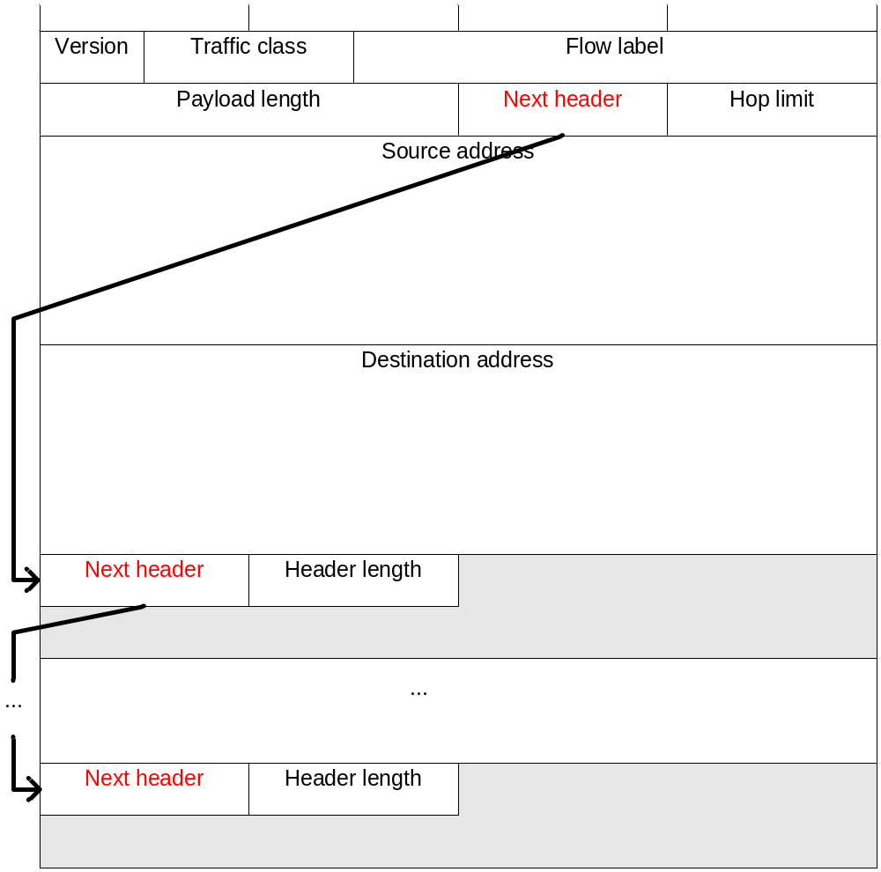
IPv6 extension headers

Slide 47
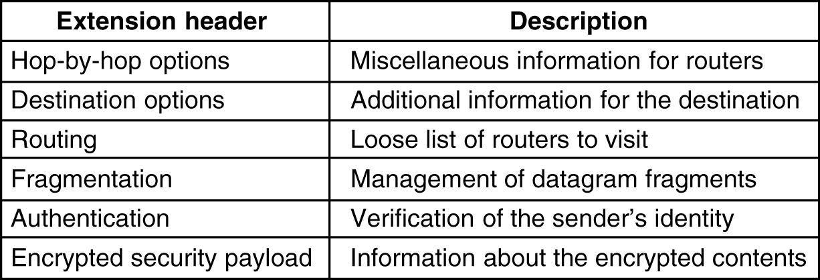
IPv6 extension headers
It is used to carry information that all the headers along the path must examine. One option has been defined so far: support for datagrams that exceeds 64K; when used, the payload length field in the main header is set to zero.
Destination options - intended for fields that may be interpreted only at the destination host
Routing header – lists one or more routers that must be visited prior to reaching the destination
Fragmentation – deals with fragmentation, similarly with IPv4; this header holds the datagram identifier, fragment number and a bit telling whether more fragments will follow; in IPv6 only the source host can fragment the packet (unlike IPv4)
Authentication – header that provides a mechanism so the receiving station is sure of who sent the packet (who is the source)
Encrypted security payload – header that makes possible to encrypt the content of a packet so that only the intended recipient can read it; these headers use cryptographic techniques to accomplish their mission
Notes:
They are optional, if exist, they should appear after the fixed 8 bytes header, preferably in the listed order
Hop by hop options - it is used to carry information that all the headers along the path must examine. One option has been defined so far: support for datagrams that exceeds 64K; when used, the payload length field in the main header is set to zero
Destination options - intended for fields that may be interpreted only at the destination host
Routing header – lists one or more routers that must be visited prior to reaching the destination
Fragmentation – deals with fragmentation, similarly with IPv4; this header holds the datagram identifier, fragment number and a bit telling whether more fragments will follow; in IPv6 only the source host can fragment the packet (unlike IPv4)
Authentication – header that provides a mechanism so the receiving station is sure of who sent the packet (who is the source)
Encrypted security payload – header that makes possible to encrypt the content of a packet so that only the intended recipient can read it; these headers use cryptographic techniques to accomplish their mission

Slide 48
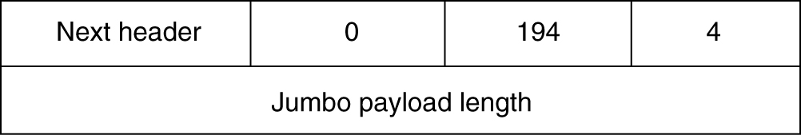
Hop by hop extension header
Next header – byte that shows what kind of header is next
Header length – how long the hop-by-hop header is in bytes, excluding the first 8 bytes that are mandatory
Type – for this case is code 194 showing that this option defines the datagram size
Length – one byte representing the length of the option, saying that the option value is represented on 4 bytes. It is followed by 4 bytes containing the option value; sizes less than 65536 bytes are not permitted and the routers will issue an error message if happens.
Datagrams using this header are called jumbograms
Their use is important for supercomputers that must transfer gigabytes of data, in an efficient way, over Internet
Notes:
Next header – byte that shows what kind of header is next
Header length – how long the hop-by-hop header is in bytes, excluding the first 8 bytes that are mandatory
Type – for this case is code 194 showing that this option defines the datagram size
Length – one byte representing the length of the option, saying that the option value is represented on 4 bytes. It is followed by 4 bytes containing the option value; sizes less than 65536 bytes are not permitted and the routers will issue an error message if happens.

Slide 49
References
Behrouz A. Forouzan – Data Communications and Networking, ISBN: 0-07-118160-1
Andrew S. Tanenbaum – Computer Networks, ISBN: 0-13066102-3
www.daemon.org/ip.html

